Slide 1
Quantum KNN experiment
10/04/2021

Slide 2
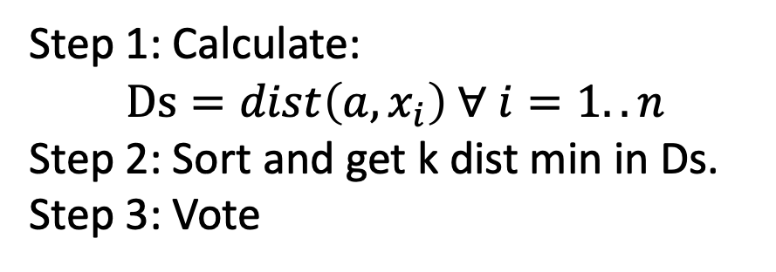
2. KNN version quantum
Step 1: Calculate:
$$Ds=dist\left(a, x_{i}\right) ∀ i=1..n$$
Step 2: Sort and get k dist min in Ds.
Step 3: Vote

Slide 3
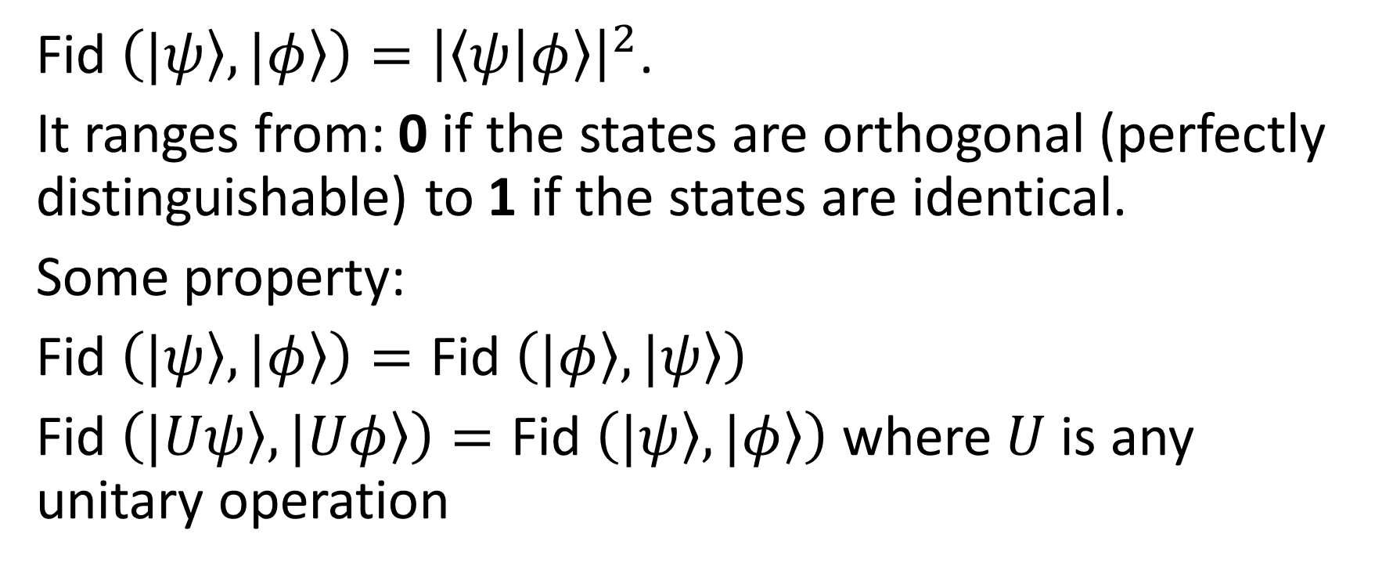
2.1. Similarity between vectors (quantum states)
Fid $\left(\left.|ψ\right\rangle ,\left.|φ\right\rangle \right)={\left|\left\langle ψ | φ\right\rangle \right|}^{2}$.
It ranges from: 0 if the states are orthogonal (perfectly distinguishable) to 1 if the states are identical.
Some property:
Fid $\left(\left.|ψ\right\rangle ,\left.|φ\right\rangle \right)=\text{Fid} \left(\left.|φ\right\rangle ,\left.|ψ\right\rangle \right)$
Fid $\left(\left.|Uψ\right\rangle ,\left.|Uφ\right\rangle \right)=\text{Fid} \left(\left.|ψ\right\rangle ,\left.|φ\right\rangle \right)$ where $U$ is any unitary operation

Slide 4
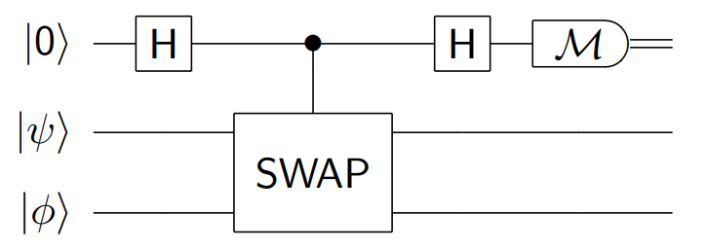
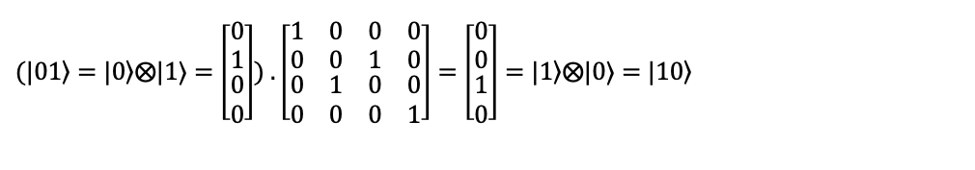
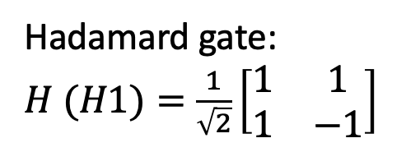
2.2. Control – Swap test
Hadamard gate: $H (H1)=\frac{1}{\sqrt{2}}\left[\begin{matrix}1 & 1 \\ 1 & −1\end{matrix}\right]$
Fredkin gate
$$(\left.|01\right\rangle =\left.|0\right\rangle ⨂\text{|1⟩}=\left[\begin{matrix}0 \\ 1 \\ \begin{matrix}0 \\ 0\end{matrix}\end{matrix}\right])\text{ .} \left[\begin{matrix}\begin{matrix}1 & 0 \\ 0 & 0\end{matrix} & \begin{matrix}0 & 0 \\ 1 & 0\end{matrix} \\ \begin{matrix}0 & 1 \\ 0 & 0\end{matrix} & \begin{matrix}0 & 0 \\ 0 & 1\end{matrix}\end{matrix}\right]=\left[\begin{matrix}0 \\ 0 \\ \begin{matrix}1 \\ 0\end{matrix}\end{matrix}\right]=\left.|1\right\rangle ⨂\text{|0⟩}=\left.|10\right\rangle$$

Slide 5













$$|0⟩$$
H
H
$$|ψ⟩$$
$$|φ⟩$$
$$A$$
$$B$$
$$C$$
$$D$$
$$|r_{c}⟩$$
H
H
$$|r_{ψ}⟩$$
$$|r_{φ}⟩$$
$$U_{f}$$
$$|r_{i}⟩$$
$$H^{⊗n}$$

Slide 6
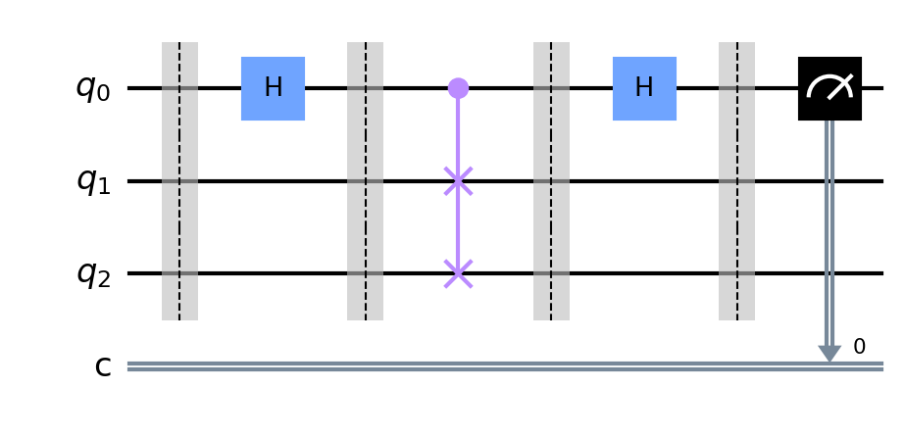




$$A$$
$$B$$
$$C$$
$$D$$

Slide 7
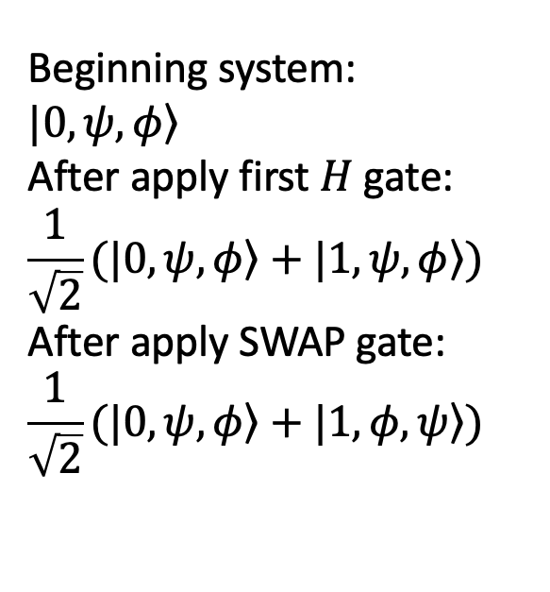
2.2. Control – Swap test
Beginning system:
$$\left.|0,ψ,φ\right\rangle$$
After apply first $H$ gate:
$$\frac{1}{\sqrt{2}}(\left.|0,ψ,φ\right\rangle +\left.|1,ψ,φ\right\rangle )$$
After apply SWAP gate:
$$\frac{1}{\sqrt{2}}(\left.|0,ψ,φ\right\rangle +\left.|1,φ,ψ\right\rangle )$$

Slide 8
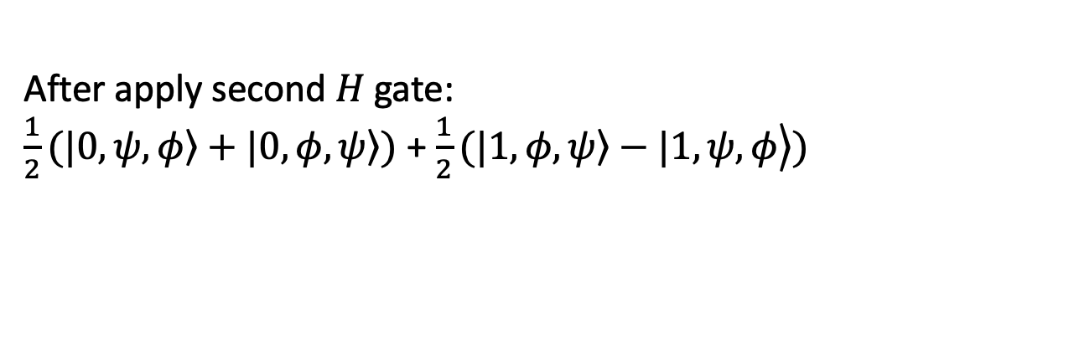
2.2. Control – Swap test
After apply second $H$ gate:
$\frac{1}{2}(\left.|0,ψ,φ\right\rangle +\left.|0,φ,ψ\right\rangle )$ + $\frac{1}{2}(\left.\left.|1,φ,ψ\right\rangle −|1,ψ,φ\right\rangle )$

Slide 9

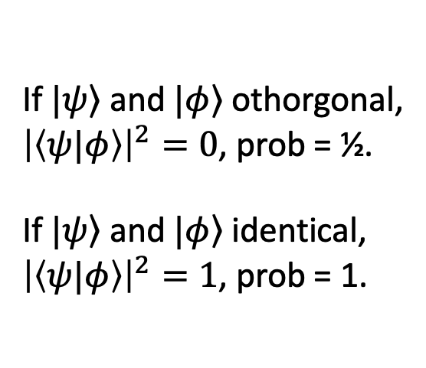
2.3. Result
If $\left.|ψ\right\rangle$ and $\left.|φ\right\rangle$ othorgonal,
${\left|\left\langle ψ|φ\right\rangle \right|}^{2}=0$, prob = ½.
If $\left.|ψ\right\rangle$ and $\left.|φ\right\rangle$ identical,
${\left|\left\langle ψ|φ\right\rangle \right|}^{2}=1$, prob = 1.
After apply measurement $M$ gate:

Slide 10
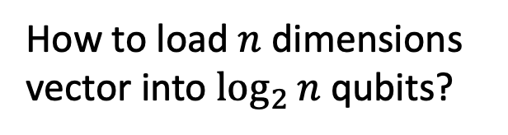
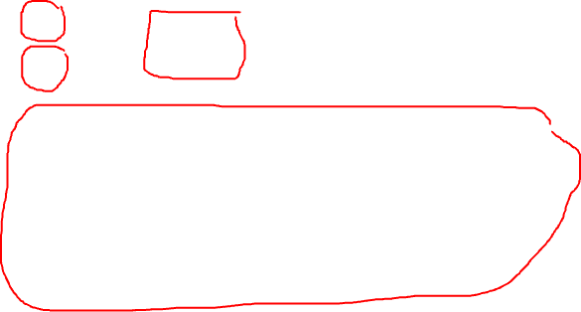
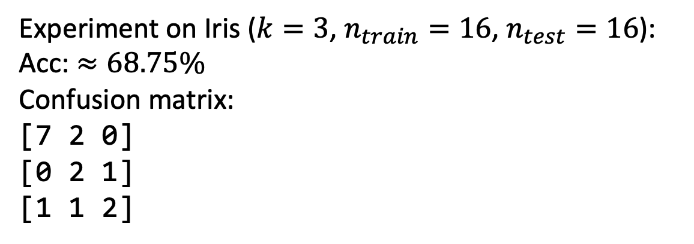
2.4. Bring QKNN to real life
How to load large classical database into circuit
How to load $n$ dimensions vector into $\log_{2}{n}$ qubits?
Experiment on Iris ($k=3$, $n_{train}=16$, $n_{test}=16$):
Acc: $≈68.75\%$
Confusion matrix:
[7 2 0]
[0 2 1]
[1 1 2]

Slide 11
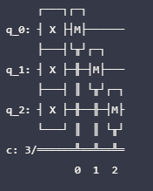
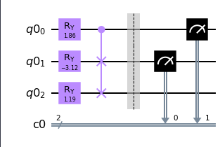


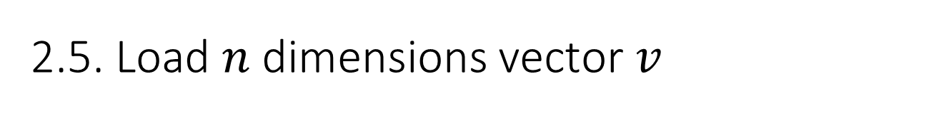


2.5. Load $n$ dimensions vector $v$
Use a set of $R_{φ}$ and Fredkin-gate
[ 0.00617277 -0.59928878 0.66390817 0.44725919]
Vector $|111⟩$
or [0 0 0 0 0 0 0 1]
Common case: $v$ is a real vector
Simplest case: $v$ is a binary vector

Slide 12

Way to train QKNN:
Combine classical and quantum
Quantum computer only calculate each 2 vector and return results to classical computer
Classical computer sorts all distances and do major vote

Slide 13
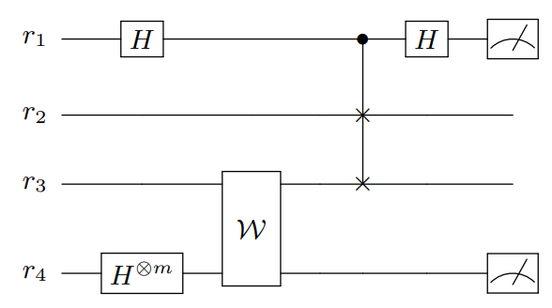
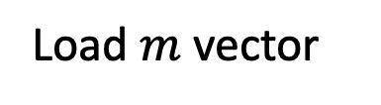
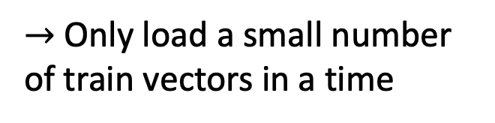

2.4.1. Load large classical database into circuit
$$|0⟩$$
Load test vector
$→$ Only load a small number of train vectors in a time
Load train vector
Convert database to an oracle (black box)
Load $m$ vector

Slide 14
1. Swaptest [8/2006] between 2 complex vectors

Slide 15
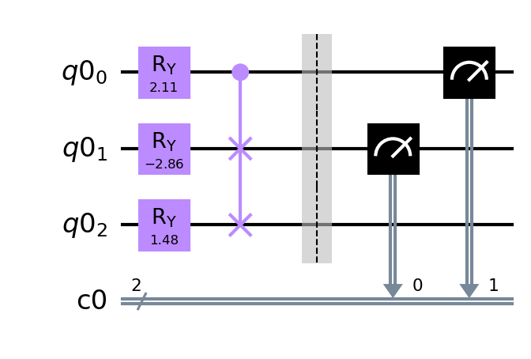
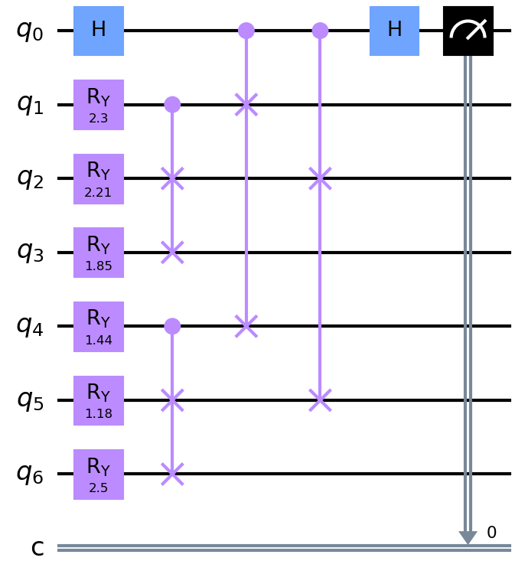






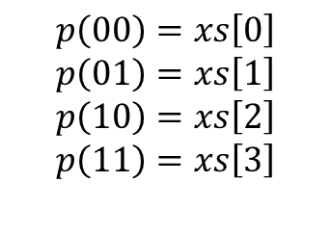


Encode one vector
(load data into circuit)
xs = [1 0 2 3]
xs = [$\frac{1}{\sqrt{14}} 0\frac{2}{\sqrt{14}}\frac{3}{\sqrt{14}}$]
Vector
Normalize
Quantum state
$p_{v_{1}}(1)$
$p_{v_{1}}(0)$
$$p\left(00\right)=xs\left[0\right]$$
$$p\left(01\right)=xs\left[1\right]$$
$$p\left(10\right)=xs\left[2\right]$$
$$p\left(11\right)=xs\left[3\right]$$
Encode $v_{1}$
Combine with swap test
$p_{v_{2}}(1)$
$p_{v_{2}}(0)$
Encode $v_{2}$
$p_{q_{0}}$

Slide 16
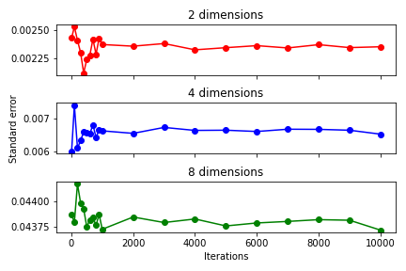
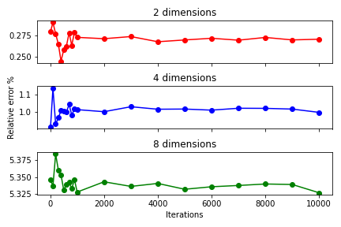
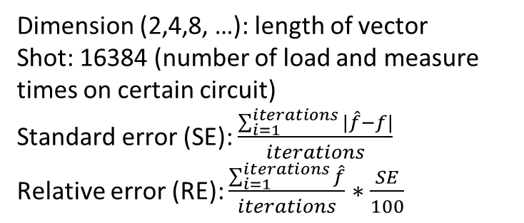
Dimension (2,4,8, …): length of vector
Shot: 16384 (number of load and measure times on certain circuit)
Standard error (SE): $\frac{\sum_{i=1}^{iterations}{|\hat{f}−f|}}{iterations}$
Relative error (RE): $\frac{\sum_{i=1}^{iterations}{\hat{f}}}{iterations}∗\frac{SE}{100}$

Slide 17
2. New QKNN

Slide 18
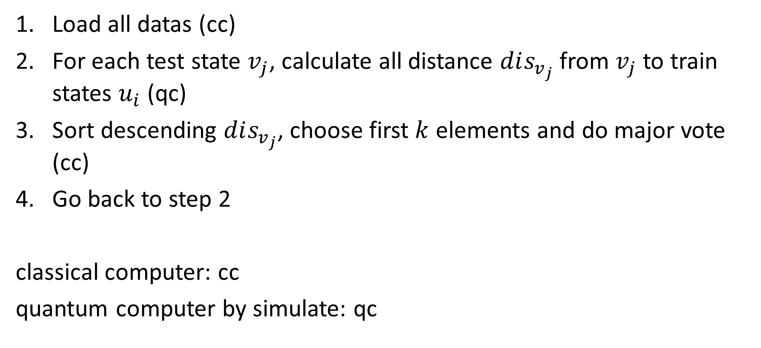
2. Algorithm
Load all datas (cc)
For each test state $v_{j}$, calculate all distance $dis_{v_{j}}$ from $v_{j}$ to train states $u_{i}$ (qc)
Sort descending $dis_{v_{j}}$, choose first $k$ elements and do major vote (cc)
Go back to step 2
classical computer: cc
quantum computer by simulate: qc

Slide 19
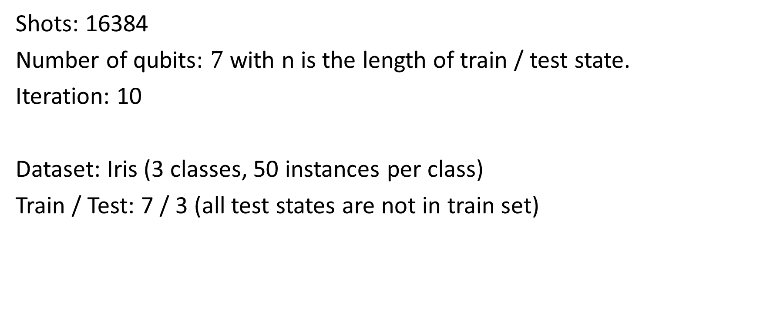
3. Experiments
Shots: 16384
Number of qubits: $7$ with n is the length of train / test state.
Iteration: 10
Dataset: Iris (3 classes, 50 instances per class)
Train / Test: 7 / 3 (all test states are not in train set)

Slide 20
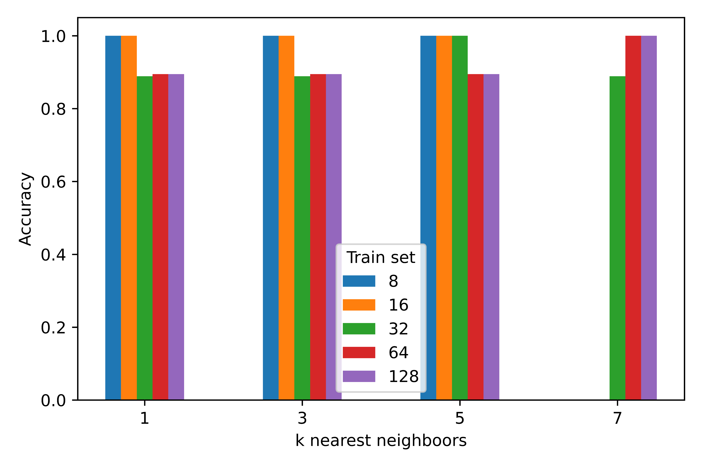
3.1. Accuracy

Slide 21



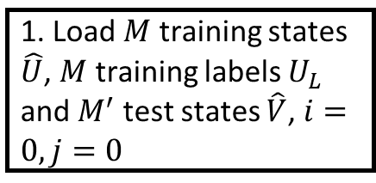




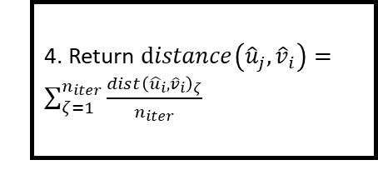







Classical computer
Quantum computer
1. Load $M$ training states $\hat{U}$, $M$ training labels $U_{L}$ and $M^{′}$ test states $\hat{V}$, $i=0,j=0$
2. Create integrated swap test circuit for $u_{j}$in $\hat{U},$ ${\hat{v}}_{i}$ in $\hat{V}$, $ζ=0$
$$F$$
$$F$$
5. Append $dist\left({{\hat{u}}_{j},\hat{v}}_{i}\right)$ into list $distances_{v_{i}}$, increase $j$ by one unit
Begin
$$j=M$$
3. Calculate $distance{\left({\hat{u}}_{j},{\hat{v}}_{i}\right)}_{ζ}$, increase $ζ$ by one unit
$$i=M^{′}$$
$$T$$
$$T$$
6. Sort descending $distances_{v_{i}}$ and choose first $k$ elements
End
$$F$$
$$ζ=n_{iter}$$
$$T$$
7. Label ${\hat{v}}_{i}$by majority voting with training labels $U_{L}$, increase $i$ by one unit
4. Return $distance\left({{\hat{u}}_{j},\hat{v}}_{i}\right)=\sum_{ζ=1}^{n_{iter}}{\frac{dist{\left({{\hat{u}}_{i},\hat{v}}_{i}\right)}_{ζ}}{n_{iter}}}$

